Slide 1
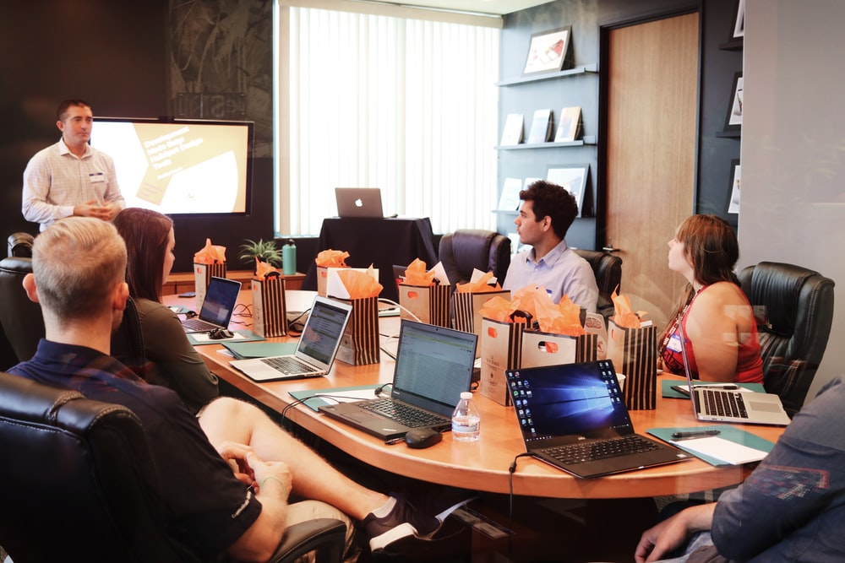
Entrepreneurship Essentials
Business Plan
@%$W%$*&%*&*&%&^$$^*^*^$^*$*&&^%^&%%
Lecture Note # 12
Business Plan

Slide 2
Concepts Covered:
Elements of a business plan
Importance of the various components
Information contents
Preparing winning business plan
Writing a winning business plan
- a book by Vaughan Evans
https://www.15minuteplan.ai/

Slide 3







Identify a pain
Empathize by suffering the pain.
Set your vision
Problem Identification, Idea generation, Screening, and Selection Phase
Feasibility
Generate ideas
Capital, technology, financial, environmental, any government restriction
Come up with many ideas
Commencement
Elementary market research
Assess value proposition
Do you see a superior value proposition?
Are there unmet demands? Are the customers crying for a solution or a better solution?
Inputs availability
Demand-supply
Raw-materials, utilities, technical resources.
Are there more demand than supply.

Slide 4








8
1
Make a business plan
Idea Generation
Prepare a detailed business plan for pitching
Innovate new ideas to solve the problem
BUILDING MVP
7
VALIDATION
2
Register your company only when absolutely necessary
Build MVP
The inherent conflict of Ideas would be known when a prototype is built
Register while approaching to investors
6
3
Prepare roadmap
Finalize co-founders
Plan for hiring
Plan for early funding
Examine financial model
Revenue model and cost structure
Identify early adopter customers
Market discovery
4
Identify your target market, assess the demand-supply dynamics, validate a product-market fit, and craft a compelling value proposition.
Customer validation of MVP at different stages of product development is a must.
5

Slide 5





Prepare roadmap
MOVING AHEAD
01
Try bootstrapping
Try delaying fundraising as long as possible.
Bootstrap, approach friends and relatives.
Approach angel investors once you have a validated model.
Apply for all government benefits
02
DSIR – Department of Scientific & Industrial Research -PRISM
TIFAC – SRIJAN seed money
SIDBI – Equity funding by SIDBI Venture Capital Ltd.
MSME – Several schemes for startup
03
Validate your product
Follow the Built-Measure-Learn cycle of the Lean Startup model.
04
Craft go-to-market strategies
Make a preemptive plan for execution, hire required manpower, and place proper business process management in operation.

Slide 6
Phase | Activities | Sources of funds | Team and hire
Identify pain point | Empathize | Bootstrap, Own fund | Optional
Motivation | Participate in idea generation events | Bootstrap, Own funds | Work in team
Build MVP | Product/service innovation | Bootstrap, friends, relatives | Find cofounders Prepare business plan
Join incubation program | Refine product through validated learning | Angel investors | Hire early employees with complementary skills, register company
Join acceleration program | Business model innovation | Angel investors | Market discovery Network with suppliers and customers
Go-to-market strategies | Create your USP | Angel investors/ Early stage venture capital | Execution
Business process management | Business process innovation | Venture capital | Make proactive plan Hire
Growth strategies | Customer experience innovation | VC rounds | Hire a professional CEO

Slide 7





Hackathon
Engaging students to identify pain point and produce ideas, fund for proof-of-concept model building
The Roles of IIT Kharagpur in Promoting Entrepreneurship
SEEDING IDEA
Motivation
. Educate students on myths and realities. Impart foundational knowledge through classroom teaching
Partnership with government agencies
IDEA SCREENING
PROMOTION OF ENTREPRENEURSHIP
Curriculum integration
Mentoring
Integrate academics with venture creation. Mentor students with early ideas, assess techno-commercial feasibility, help them pivot early, frame business plan. Provide funds.
DESIGN-DEVELOP
Faculty engagement
VALIDATION
Incubation
Acceleration
LAUNCH
Incubation
Provide basic infrastructure for converting ideas into MVPs, hiring interns, validation, and filing for IP.
Provide seed funds.
Industry partnership
Acceleration
Refine product, refine business model, discover customers, connect investors. Engage alumnae

Slide 8
Steps to Start a Start-up
Identify an unmet need or problem within a group, empathize, define the pain as completely as possible, and explore a compelling solution.
Assemble a well-rounded team of co-founders with complementary skills and shared vision. Conduct thorough market research before proceeding to establish the company.
Understand the target group, define the problem, ideate solutions for product-market fit, explore incubation and seed funding, and recruit tech experts to address skill gaps.
Embrace the lean startup approach: build, measure, learn, and create a go-to-market plan grounded in market understanding and marketing strategies. Join acceleration programs and connect with angel investors.
Prototype

Slide 9
Build the Business
Develop infrastructure for projected sales, estimate cash flow, stay in touch with investors for potential fundraising, and collaborate with key input suppliers.
Execute targeted marketing strategies for enhanced customer awareness. Prioritize retention and innovation to foster sustained customer growth.
Establish logistics aligned with customer preferences and forge Collaboration with distributors, dealers, mega-retailers, and e-commerce platforms.
Consistently gather customer feedback and enhance your solution to exceed their expectations.
Steps to Start a Start-up
Infrastructure

Slide 10
Growth Strategies
Set realistic targets. Identify key growth indicators and allocate resources accordingly. Monitor daily sales closely and promptly address any issues that arise.
Constantly monitor competitors, proactively preempt their strategies when feasible, and respond swiftly to maintain your competitive edge.
Assess resources and invest in talent. Analyze customer feedback, address complaints, and foster a positive work environment.
Sustain product development efforts, stay ahead of competitors with new launches. Proactively forecast funding needs and secure funds proactively.
Steps to Start a Start-up
Launch

Slide 11








Timeline of a Startup
Build MVP
Pain point
Piloting
Early adopter
Growth plan
Empathize, define, generate ideas
Validated learning Refinement of product based on feedback
Register company
Seed marketing
Innovator type customers
Go-to-market strategy
Strategies to grow
Scaling
Geographical expansion
Acquire market share
Hire professional CEO for growth phase
01
02
03/4
05
06
07
08
09
Put in place required infrastructure for mass production
Market research
Traction
Funding
Incubation
Angel investment
Make the MVP
Build team
Hire interns
Strategies to acquire customer
Plan for building brand
Journey so far
Future plan
Present
Next

Slide 12
Jeff Bezos on information economy of decision making
Pareto 80:20 Principle or the law of the vital few
In product development, marketing, manufacturing, and several other events, roughly 80% of the effects come from 20% of the causes.
In marketing, 80% of your sales comes from 20% of your customers.
“Most decisions should probably be made with somewhere around 70% of the information you wish you had. If you wait for 90%, in most cases, you’re probably being slow...If you’re good at course correcting, being wrong may be less costly than you think, whereas being slow is going to be expensive for sure.”

Slide 13
Try generating 70% of the information and make fast decision on market and move forward.
More information may take huge incremental time and may be overly costly, whereas may not meaningfully add to accuracy.
The new reality: fast and steady wins the race.
We must be able to do increasingly more with increasingly less.

Slide 14
Persistence and hard work with a never-say-die attitude is essential to achieve success.
Elon Musk makes the point from his own experience
“Even if your product is failing, you should stick with it if you believe [?] that your idea has what it takes to be successful.”
He provides a supplementary anecdote, stating that “Tesla almost failed”. However, Elon Musk stuck with Tesla, and on the day, Tesla was due to file bankruptcy, Elon Musk miraculously got enough investments to pay off his debts. Today, the market value of Tesla is > $826 B in 2023 (crossed 1
2 trillion in 2021).
But be realistic – make sure you are not beating a dead horse.
“Only those who dare to fail greatly can ever achieve greatly.” – Robert Kennedy
“If my mind can conceive it and my heart can believe it, then I can achieve it.” – Muhammad Ali
“The successful warrior is the average man, with laser-like focus.” – Bruce Lee
Notes:
Nick Swinmurn – Zappose, Drew Houston - drop box

Slide 15
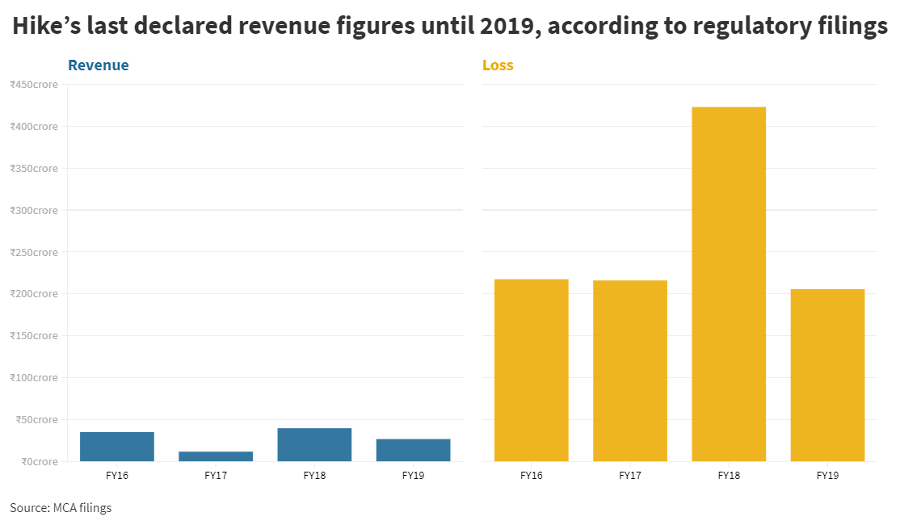
Hike – the 10th unicorn of India with $1.4 billion valuation
Loss
Revenue
Investment received: $ 261 million +
Tencent, Tiger Global and Bharti SoftBank

Slide 16
Growth Hacking How much growth is too much?
Some current development and lesson to be learned
Kavin Mittal
Mittal took to Twitter to announce the shutting down of Hike Messenger.
Founded in 2012
The startup showed promise, quickly got the attention of investors — including Chinese messaging giant WeChat’s parent — and was valued at 1 billion dollars within four years of launch.
Hike in late 2016 boasted having 37 million monthly active users (MAU) and 18 million daily active users (DAU).
Couple of bad hiring mistakes costed them dearly.
“We should have adapted to the market, we couldn’t. That was the key reason. There was a period in which we went from 150 people to 400 very fast,” he said.
“We had built a phenomenal culture at Hike until 150 people. But we were going too fast and when you make hiring mistakes at the top, it all comes tumbling down," he said.

Slide 17
Here is what Mittal rued:
“Emotionally we have moved on, it’s a part of building a new company. We have seen a lot of success, we have seen some big downfalls,” he added after quoting a popular Silicon Valley adage, ‘building a business is like waking up in the morning and eating broken glass everyday’ ̶ Kavin Mittal
After Hike's closure, Mittal pivoted the company to focus on building the Rush Gaming Universe, a mobile gaming application.

Slide 18
Business Plan: Definition
A Business Plan is a strategic blueprint outlining your vision for the future, systematically detailing the key components and strategies essential for achieving success.
In its simplest form, a business plan is a guide—a roadmap for your business that outlines goals and how you plan to achieve those goals.
Ideally, the plan explains why you think you will be successful, leveraging the strengths and opportunities given the challenges ahead.

Slide 19
As Dharmesh Shah, Co-Founder and Chief Technology Officer, HubSpot writes at Entrepreneurs.com
“The problem with business plans is that things change so quickly in the startup world. Before the ink is even dry on that 100+ page business plan as it shoots out the printer, things have already changed and "the plan" is already outdated. …
Very few startups I know – or companies I’ve invested in – resemble their original business plan.”
Things are changing too fast.
HubSpot is an American developer and marketer of software products for inbound marketing, sales, and customer service. HubSpot founded by Brian Halligan and Dharmesh Shah in 2006. Current valuation: US$ 26 B

Slide 20
The Purpose of Business Plan The flavour may vary based on context
Entrepreneur’s ready reckoner – a dynamic plan that continuously evolves over time: – more strategy and milestone oriented.
Fund raising – Angel and VC (equity) – focuses on success factors, risk factors & how do you plan to mitigate them, traction, progress in product development and validation, financial projection, exit strategy: - more traction and futuristic.
Fund raising (debt) – present and future financials.
Business plan competition as in ‘2.’ above plus social values.

Slide 21
The Purpose of Business Plan The flavour may vary based on context
Incubation – as in (2) above.
Acceleration – as in (2) above.
Customer connection – past and present financials.
Mentor connection – as in (sl. no. 1).
Potential buyer of your company or acquirer (in merger & acquisition deal) – present and future financials, customer base, .
The myth related to business plan
Once you have an idea, the first thing you do is prepare the business plan

Slide 22
The Purpose of Business Plan The flavour may vary based on context
Whatever is the motivation to write a business plan, your audience would be interested to know how you navigate through challenges to emerge successful and create value.
Your focus must be to bring to light the story of that journey.

Slide 23
Essence or Consideration for Building a Business Plan
Words are tools for conveying ideas.
Investors are busy.
They want you to convey as much as possible in as less words.
No poetic phrases
Follow the lean philosophy. Give an MVP of the plan
Anybody loves to hear a good story with strong words. Tell yours.
Gather all possible information about pitfalls.
Highlight the risks as much as the prospects.
Show investors the money.
Notes:
Painting a mental picture of how a specific customer will benefit or has already benefited from the new product or service packs a wallop.

Slide 24
Demonstration of a Working Model Is Very Convincing
It’s a good idea to demonstrate a working prototype, should you have one.
Don‘t worry even if it is your MVP and looks shabby. It should demonstrate the value proposition.
A working prototype is a true validation of your claims about the novelties of your product or service.

Slide 25

Four Factors Critical to Every New Ventures and They Should Receive Pride of Place in Your Business Plan
The people – Founders, employees, mentors, directors: team chemistry, track record, complementary skills.
The opportunity – what you will sell and to whom (what pain you alleviate with what efficacy: competitive advantages), how you will make money. The unique value proposition. The Market Structure: the size and growth potential of the market, the competition.
The context – the big picture – the present business scenario with particular reference to the opportunity. The growth prospect of the market segment. Market structure. Bill Gross (timing as the most important factor for success)! Victor Hugo!
The risk and reward – things that can go wrong and the potential gain if the team can do things right.
“Nothing else in the world…not all the armies…is so powerful as an idea whose time has come.”–Victor Hugo,

Slide 26
Highlight Your USP and Your Value Proposition to Customers
The USP helps determine whether there is any reason for a buyers to purchase your product instead of continuing to use established ones.
USP is a combination of factors that set your product apart (differentiator) from competitors and conveying customers the reasons why they should buy your product (delivery, return policy, aftersales service).
USP should be projected as if it is in your company’s DNA.
Effectiveness of a USP depends on how well it resonates with the target audience and addresses their needs or pain points.
USPs
Innovative Technology, Cost-Effective Solutions, Customer-Centric Approach, Sustainability, Agility and Flexibility, Unique Design or Branding, Personalization, Social Impact, Ease of Use, Speed and Efficiency

Slide 27
Examples of USP
FedEx Corporation: "When it absolutely, positively has to be there overnight.“
Avis: "We're number two. We try harder."
M&Ms: "The milk chocolate melts in your mouth, not in your hand."
Dominos Pizza: "You get fresh, hot pizza delivered to your door in 30 minutes or less, or it's free."
Vicks NyQuil UP, "The night-time, coughing, achy, sniffling, stuffy head, fever, so you can rest medicine"
Bee’s Wrap: “A Simple Solution to Plastic Pollution”
Geico: "15 Minutes Could Save You 15 Percent or More on Car Insurance."
Enterprise: "Pick Enterprise. We'll Pick You Up."
Notes:
Zappos

Slide 28
Broad Components of Business Plan in Most of the Templates
Cover page: Invest in designing the cover so it stands out.
Executive Summary
Contents: it tells your audience what to expect in the report.
The Detailed Plan (the core business model)
Conclusion
Appendices

Slide 29
Major Components of Business Plan in Most of the Templates
Executive summary: give it your best shot.
The Business (Background & business mix) – how did you get here, the pain point, the market, why this business, why now, where are you now?
The market & market demand – segment, market size, growth, competition, channel, your advantages.

Slide 30
Major Components of Business Plan in Most of the Templates contd. …
Competitive advantage and your value proposition.
Strategies, Operation management – your value, plan for a lean system, suppliers and buyers management.
The resources: The team – key skills in the field of technology, management, marketing, and operation.

Slide 31
Major Components of Business Plan in Most of the Templates contd. …
Financial outlay and financial closure, projected financials – gist of profit & loss, cash flow statement, break-even point
Risks, Opportunities and Sensitivities
Conclusion
Appendices – detailed profit & loss account, balance sheet, cash flow statement, detailed project cost, market survey report (if any) and other reports and images you think make a difference to the impression of your audience. The brief resume of all the founders and key employees may also be attached.
Essential Guides – Writing a Business Plan Vaughan Evans, Financial Times

Slide 32
Many Templates. Fundamentally they are similar. The Template of HBP.
Summary
Business
Market demand
Competition
Strategy
Resources
Financials and forecast
Risk, Opportunities and Sensitivities

Slide 33
Template by Sequoia Capital
“We like business plans that present a lot of information in as few words as possible. The following business plan format, within 15–20 slides, is all that’s needed.”
Company Purpose
Problem
Solution
Why now
Market size
Competition
Product
Business model
Team
Financials
https://www.sequoiacap.com/india/article/writing-a-business-plan/

Slide 34
Source: Forbes, Created by Dave Lavinsky
Business Plan Outline - 23 Point Checklist For Success
Section I – Executive Summary
Section II – Company Overview
Section III – Industry Analysis
Market Overview
Relevant Market Size
Section IV – Customer Analysis
Target Customers
Customers’ Needs
Section V – Competitive Analysis
Direct Competitors
Indirect Competitors
Competitive Advantages
Section VI – Marketing Plan
Products & Services
Promotion Plan
Distribution Plan
USP
Continued …
www.forbes.com › sites › davelavinsky

Slide 35
Business Plan Outline - 23 Point Checklist For Success … contd.
Section VII – Operations Plan
Key Operational Processes
Milestones
Section VIII – Management Team
Management Team Members
Management Team Gaps
Board Members
Section IX – Financial Plan
Revenue Model
Financial Highlights
Funding Requirements
Use of Funds
Exit Strategies
Section X – Appendix
Supporting Documentation

Slide 36



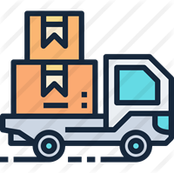




Customer Relationship
08
07
02
01
Value Proposition
04
Key Partners
Key Activities
Customer Segment
03
Key Resources
06
Channel
Revenue Model
05
09
Cost Structure

Slide 37
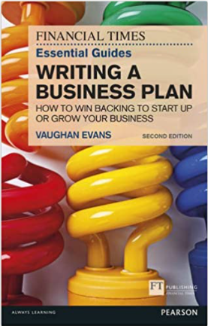
Writing a winning business plan
The following slides are inspired by the book of Vaughan Evans
The Financial Times (Pearson)
Essential Guide to Writing a Business Plan
How to win backing to start up or grow your business
Vaughan Evans
Second edition - 1 October 2015

Slide 38
Chapter 1: Executive Summary Chapter 2: The business Chapter 3: Market demand Chapter 4: Competition Chapter 5: Strategy Chapter 6: Resources Chapter 7: Financial Outlay, Financial Closer, and Projected Financials Chapter 8: Risks, Opportunities, Rewards and Sensitivities
The following are the book chapters explaining different chapters of a business plan

Slide 39
Chapter 1: Executive Summary
The business
The team
The proposal
Why now
Why it will succeed
What the rewards will be (to the investors)
Major risks and how you can minimize them

Slide 40
Executive Summary
Chapter 1
Executive Summary
For most readers it will be the first few pages or the only pages they read. Some senior decision-makers will read nothing else.
Spend time on it, nurture it, hone it and edit it remorselessly, even give it to a professional to edit. It may be the best investment you make. - Vaughan Evans

Slide 41
Summary – Makes the First Impression
Chapter 1
Executive Summary
Research evidences that we create an impression about a person we meet in the first 15 seconds. If you are presenting for say 5 minutes, you create a lasting impression that is hard to shift later.
Must be persuasive.
Should cover all the key issues.
Try to be detailed but brief - provide all key information in a precise way.
Show your compelling reason for promoting the business.
Why now?
Make it short and interesting and keep people expecting more.
Notes:
(antonyms: scruffy, shabby, untidy or dirty)

Slide 42
Chapter 2: The business
Chapter 2
The Business
Background
Business mix by segment

Slide 43
Background
Chapter 2
The Business: Background
You brief your audience on the bare essentials – what the company does, for whom, why, where, with whom, with what and how it got to where it is now.
Highlight the traction. You’ll briefly set out why the business is poised to enjoy a sustainable competitive advantage.
Introduce more detail on the background to your business than you will have set out in the executive summary. Remember that your plan is to be a short, sharp, punchy document aimed at hooking your audience.
This is where the reader is introduced to the business, where you set out clearly and concisely what makes the business tick.

Slide 44
The items in the ‘Background’
Chapter 2
The Business: Background
The opener
Goals and objectives
Strategies
Resources
Basic financials.

Slide 45
The opener should be just one paragraph containing:
Chapter 2: The Business: Background
The opener
Goals and objectives
Strategy
Resources
Basic financials.
Who you are – the name (or code name, if yours is a confidential plan) of your business.
What products or services it focuses on.
Which main customer groups your business serves.
Where it is based, where else it has operations and where it sells.
With what success, in terms of revenues and operating margin (operating profit divided by sales), and
By Which year you will achieve.

Slide 46
The Goals and Objectives
Chapter 2: The business: Background
The opener
Goals and objectives
Strategy
Resources
Basic financials.
Your goal is to become customer-centric. So your objective may be %satisfied customers. Put a number: say 40% of our customers will rate highly satisfied 2027.
You may set the goal in terms of market share. Now put data to set the objective: you are working to gain 10% market share by the end of 2026.
Goals are directional, objectives are specific. You may have come across the useful acronym SMART for setting objectives, which stands for Specific, Measurable, Attainable, Relevant, and Time-limited.

Slide 47
Strategy
Chapter 2: The business: Background
The opener
Goals and objectives
Strategy
Resources
Basic financials.
What strategy you adopt to build and maintain competitive advantage.
How is your offering differentiated, unique features that customers love, technically superior, convenient purchase & delivery, hassle-free maintenance, and many more.

Slide 48
Resources
Chapter 2: The business: Background
The opener
Goals and objectives
Strategy
Resources
Basic financials.
Highlight the key resources such as strategic location, existing infrastructure including office, access to strategic assets, technologies, IP, team and mix of skills, mentors, key employees, any arrangement with suppliers and distribution, any acquisition plan.
Good to have an infographics and timeline.
Write a separate paragraph on your team including key employees. Highlight the credentials of the team and how the skillset and experience will help in executing the business model.
You may also mention their key responsibilities and ownership.

Slide 49
Chapter 2: The business: Background
The opener
Goals and objectives
Strategy
Resources
Basic financials.
List requirements and availability for the following resources:
Personnel
Technology
Finances
Distribution
Promotion
Products
Services

Slide 50
Basic financials
Chapter 2: The business: Background
The opener
Goals and objectives
Strategy
Resources
Basic financials.
Provide a summary of key financial metrics such as sales and operating profit.
In case no sales has been made so far, state the major expenses incurred, the source thereof and the time it required.

Slide 51
The business mix by segment
Chapter 2
The Business
Background
Business mix by segment
Clearly define which group of people or businesses constitute your main customers.
What products or services you are offering them. Which of them will critically contribute to your business success?

Slide 52
The business: Customer segment
Chapter 2
The Business: Business mix by segment
Who are the target customers (define customer persona)?
In which way will they benefit from your offering?
How do you offer a superior product-market-fit compared to your competitors?
How do you target them and position your product?
You need to mention evidence such as market research data or validation by number of users and their responses.

Slide 53
The business: Customer segment
Chapter 2
The Business: Business mix by segment
Try identifying niche and creating sub-segments to offer differentiated products to target customers of specific needs (features).
But focus on the product-segment that will make or break your business.

Slide 54
Chapter 3: Market demand
It is important that there are enough customer to buy your product at a profitable price. Else, your plan will not materialize.
Thus, this section is one of the most important and you must make all out effort to make it as convincing as possible with real data. Do not try to suppress facts. If it is declining you must have a plan to reverse the trend.
Market size
Market growth
Market demand for a start-up
Test marketing
Estimate your addressable and obtainable market

Slide 55
Market demand
Chapter 3
Market demand, risks and opportunities
Market share change – give a competitive intensity of your market and your competitive position.
That market must be of sufficient size, now and in the future, to support at least your business, not to mention your competitors.
Your market must buy your product for you to have a business. Your market must look attractive. Else you should not pursue it.
Your reader wants to know, before all else, who these buyers are, how much they are buying, how much they are paying, why they are buying, what has been influencing them, how those influences may change and how much they are likely to buy in the future.
The market demand

Slide 56
Chapter 4: Competition
“ Competition’s a bitch – but that’s what gives us puppies.” – Unattributed
Understand and respect the competition & competitive intensity. Give competitors the space they merit in your plan. Dismiss them and your readers will dismiss you.
Your USP: How you are going to stand out in the competition? What product features, quality, technology, service differentiator you have to beat competition.
Porter’s five forces analysis of your business.
Your value proposition.

Slide 57
Chapter 5: Strategy
“ We shall either find a way or make one.” - Hannibal
you assess what your competitive position will be upon entering this market and how that may improve over the next three years.
How competitive is your business in each of its main segments? What is your strategy for strengthening competitiveness in key segments? Or boosting the balance of your overall portfolio of segments? What risks may you face and what opportunities can you exploit?

Slide 58
Strategy
Neither you exaggerate your opportunities, nor you gloss over the risks.
Be realistic.
Tell your strategies to beat the competition.

Slide 59
There are several ways you can try to sustain your competitive advantage
Patent protection of key products you have innovated.
Sustained innovation to stay ahead in product development.
Continuous improvement of the process to reduce cost.
Content marketing.
Investment in branding and creating loyal customers.
Investment in customer relationships, particularly for business-to-business ventures.

Slide 60
Chapter 6: Resources
“ It’s not the size of the dog in the fight, it’s the size of the fight in the dog.” – Mark Twain
Most investors say that they back the team.
In startups, investors do not look for managers. They look for visionary leaders, a person who believes wholly in the product or service, who will inspire and motivate others in the team.

Slide 61
Resources
Technology requirement
Personnel requirement
Inputs requirements – raw-materials, services, and utilities
Logistic requirements – distribution, sale, delivery and aftersales services.
Financial requirements

Slide 62
Resources - Personnel
Management – how you will have the right team of managers, with the right experience, qualifications and skills to implement the strategy.
Marketing – how you will create sufficient awareness of the firm’s offering over the plan period, a crucial issue in a start-up.
Operations – how you will deploy your resources to ensure that supplies, purchasing, manufacturing/service provision, R&D, distribution, sales, customer service, systems, control and compliance are sufficiently aligned to deliver the plan.

Slide 63
Chapter 7: Financial Outlay, Financial Closer, and Projected Financials
Year | I | II | III
Total requirement of fund
Number of Customers/ registered users
Revenue
Gross profit
Operating profit
Net profit

Slide 64
Financial Outlay before commercial operation: to be given in Appendix

Slide 65
Financial Outlay and Financial Closure
This part is for the Appendix.
Only the brief should be provided in the main body.

Slide 66
You should present the following financial projections
A forecast P&L account –the sales is framed using market research data and profit margins is determined based on competition.
A forecast cash flow statement – this will indicate liquidity.
A forecast balance sheet – will show that forecasts is achievable with an acceptable capital structure (the balance of debt and equity).
Present here only the gist and give the details in the Appendices.
The actual performance may be far different and investors know it very well. But the way you prepare them shows your understanding of the business. So, prepare them diligently. Mind your assumptions.

Slide 67
Chapter 8: Risks, Opportunities, Rewards and Sensitivities
Chapter 8
Risk, Opportunities and Sensitivities
“ When written in Chinese the word ‘crisis’ is composed of two characters. One represents danger, and the other represents opportunity.” - John F. Kennedy
Opportunities are hidden in adversities. Explain how you are transforming challenges into opportunities.
Sensitivities – how sensitive is the projected performance on changes of some of the critical factors such as input cost, price of the product, interest rates, customer acquisition cost, etc.

Slide 68
Chapter 8: Risk, Opportunities, Rewards and Sensitivities
Chapter 8
Risk, Opportunities and Sensitivities
Having forecasted the projected financials, provide the risks that you may encounter, what are the likelihood of their manifesting, how are you preparing to alleviate them? What are the worst and the best-case scenario?
You can depict the risk in a canvas with likelihood in one axis and impact on the other.

Slide 69
Risk Opportunities Canvas
Opportunity
Risk
Impact
Likelihood

Slide 70
Checklist on Risks and Opportunities
Chapter 8
Set out and weigh up the big risks and key opportunities on your way to achieving the targeted success.
Their likelihood of occurrence
The impact on bottom-line and cash flow if they do occur.
Check if there is any risk that can potentially kill your business. You must have a clear and comprehensive plan to beat it.
On balance, size and likelihood of opportunities should beat the foreseeable risks. Opportunities should outshine the risks.
Risk, Opportunities and Sensitivities

Slide 71
Rewards
Provide some estimates of the pay-off to the investors and founders.
This is important if you are pitching for fund.

Slide 72
Sensitivities
Chapter 8
Risk, Opportunities and Sensitivities
Sensitivities is numerical estimation of how your cash flow is affected if any of the big risks manifest.
Say, selling price is down by 5%, estimate the cash flow and show how your business is affected.
You can actually place a value to the negative impact of some of the key risks.
You can also draw attention to the upside of something going more favorable than projected.

Slide 73
‘Conclusion’ section of the business plan
The overall conclusion on why your business is worthy of backing (in which you summarize, preferably in bold, the main findings from the headlines below):
Market demand prospects. State your conclusions on what’s going to happen to market demand, by key business segment (Chapter 3 of your plan).
Competition. Your conclusions on whether competition is intense and set to get tougher (Chapter 4).
Strategy. Your conclusions on your firm’s competitive position and its strategy for further developing competitive advantage (Chapter 5).
Resources. Your conclusions on the resources your firm will deploy to implement that strategy and meet its goals (Chapter 6).
Financials and forecasts. Your conclusions on how your firm will grow revenues and operating margin over the next few years (Chapter 7).
Risk, opportunity and sensitivity. Your conclusions on why opportunities before your firm outshine risks in your plan.

Slide 74
Concluding remarks should be directly addressed to the audience.
Conclusion should be some music to the ears of the audience.
Make a one-line summary of the best part of your plan.
Last line should talk about the value they can expect and the value to the society. “While our business will potentially do great service to the society at large, our investors may expect a 10X returns in three years.”
Together, we can bring about great change to lives of our target customers.

Slide 75
The length
The main document should be 25–30 pages of A4, maximum 35 pages.
The main chapters on market demand, competition and strategy should be three–four pages each; those on resources and financials/ forecasts perhaps a bit longer at four–six pages each.
Chapters 2 and 8, should be just two pages each, while the conclusion should be a masterfully written, upbeat half a page.

Slide 76
Style
Style matters.
Use words sparingly. No word should appear unnecessary. But do not sacrifice on communicating key information.
Keep sentences simple but informative and of optimal carrying capacity. Remove any sentence if absence of it does not matter.
Make the most of design elements: headings, subheads, lists, and graphics. A time-constrained reader can get pretty good idea even in 15 seconds to look through.
Use graphics judiciously.

Slide 77
Information in ‘Text’ vis-a-vis ‘Graphics’
Our market research shows that 16% of the population of 500, i.e. 80 families, can be classified as middle-income and forms our target customers.

Slide 78
Should Be Able to Grab the Attention and Keep It
Serial entrepreneur and investor Steve Blank says that 99.7% of the applications for funding are rejected and only 0.3% are accepted.
That means that they receive & scrutinize 300 times more business plans than they eventually fund.
Obviously, they would neither have the time nor tenacity to thoroughly scrutinize all proposals.
Therefore, business plan should be precise but focused and should convey the winning elements in minimum words.

Slide 79
Tell Your Story
“Stories are the single most powerful weapon in a leader’s arsenal.”
– Howard Gardner
Do you have a compelling story?
Story does not mean the progression of events till date.
Story relates to your why, how and why now.
It may have some drama, but must have a compelling motivational reason
Companies are positioned within a narrative. How your audience perceives that narrative will influence how they get invested in your vision.

Slide 80
Know Your Audience and Give the Information They Need to Make Decision

Slide 81
Experts say that your business plan journey should traverse the Seven Cs
C1
Clear good plan
C2
Crisp
C3
Concise
C4
Consistent
C5
Coherent
C6
Credible and
C7
Correctness.

Slide 82
Growth Hacker Marketing
It is possible to start a company on a shoestring budget and create product that customers will love.
New generation companies such as Facebook, Dropbox, Airbnb, Twitter have not been spending a dime on traditional marketing.
They do not advertise on TV, no billboards, no newspaper ad.
They rely on a new strategy — growth hacking — to reach many more people despite modest marketing budgets.
Growth hackers have thrown out the old playbook and replaced it with tools that are testable, trackable, and scalable.
They believe that products and businesses should be modified repeatedly until they're primed to generate explosive reactions.

Slide 83
Growth hacking
A new marketing tool to achieve rapid growth on small budget.
Growth hacking helps to acquire many users at a nominal cost.
A team usually involve marketers, developers, engineers and product managers.
The growth hacker often use social media, viral contents, content marketing, influencers.
They build a story that resonates with customer’s emotion.
It must be supported by a compelling product-market-fit in order for retaining the satisfying customers once acquired leading to a viral loop of evangelists – a self-promotional model.

Slide 84
Growth Hacking
It reduces customer acquisition cost, help increasing margins, ease of product extension, and promote long term sustainable growth. Else, you will pour water in a leaky bucket.
growth hacking uses iterations to rapidly test persuasive copy, email marketing, SEO and viral strategies, to increase conversion rates and achieving rapid growth of the user base.
Techniques such as search engine optimization, website analytics, content marketing and A/B testing are used.
Growth hacker use validated learning with the help of minimum viable product.

Slide 85

Growth Hacking
Growth appears like a magic wand: as if growth is the end (success).
This can be one of the greatest of mistakes in startup marketing.
The product-market-fit, positioning the product to the target customers and meeting their exact needs better than competitors, vibrant sales funnel are indispensable.
Premature growth may ruin your business and waste your resources.
While you celebrate the growth, you may suddenly fall over the precipice.

Slide 86
How fast to grow?
Every decision that a growth hacker makes is driven by seeking measurable growth.
Vanity metrics do not indicate anything (!!!) towards a profitable and scalable business.
Create a viral loop
Choose the right growth engine
Leverage everywhere including marketing, business process management, customer service, hire people wherever necessary.

Slide 87
Viral Loop
You must be able to make your customers do the advertisement of your products to their friends (word-of-mouth advertisement or referral).
Your customer acquisition cost will be minimized and you will soon move towards profitable business.

Slide 88
Growth Hack, Vanity Metrics, and Strategies
01
Constantly review your sales funnel
Upgrade the sales funnel to create a viral loop so customers spread your message
02
Be cautious and do not follow vanity metrics. Check if it is leading to long-term value.
Check the customer acquisition cost and how quickly the cost is recoverable.
03
Define sales funnel metrics.
Are the increasing number of foot-fall getting translated into profitable sales?
04
Estimate possible virality effect
Plan, execute and measure virality to achieve real growth.
05
Update marketing plan
Put appropriate information system to collect and process data to monitor the metrics

Slide 89
Influencer Marketing
The process of creating awareness and trust on your brand through endorsement by internet celebrity or other persona.
It involves unique contents and paid media. Thus, it is a hybrid of traditional advertisements and content marketing using the internet.
Influencer are usually anybody with a large fan-following and need not be an entertainment celebrity. It can be an ordinary person with YouTube channel showing particular popular knowledge. The person can endorse a particular product just by using it in his/her content. So, it becomes natural choice for the viewers to trust that brand. Thus, influencers may be product-specific.
https://www.nytimes.com/2019/03/01/business/media/social-media-influencers-kids.html
Notes:
People have grown cynical toward advertisements. They say it shows up in every conceivable place, makes ridiculous claims, plays to our most base instincts, and crowds out things that are more interesting and essential. In a world where brands are making incredible claims and counter-claims, it is hard to trust any of the claims that marketers make. This cynicism is often eroded when a seemingly known person recommends a particular brand. The trusted source may be just a casual acquaintant on the social media. If the same

Slide 90
Customer Engagement
Customer Engagement is the emotional connection between a customer and a brand. Highly engaged customers buy more, promote more, and demonstrate more loyalty. Providing a high-quality customer experience is an important component in your customer engagement strategy.
Customer engagement is an interaction between an external consumer/customer (either B2C or B2B) and an organization (company or brand) through various online or offline channels
AI-powered recommendation systems are boosting engagement for Pinterest.

Slide 91

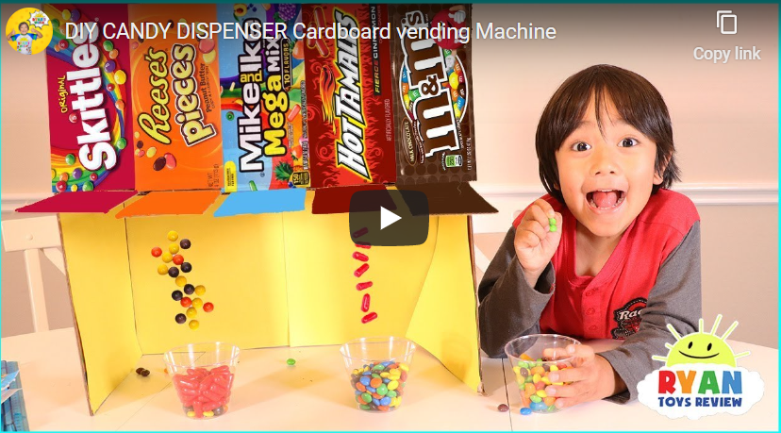
A 7-year-old boy is making $22 million a year on YouTube reviewing toys
Surely the envy of elementary-school kids worldwide, the YouTube star reviews new toys in videos that his family produces. Ryan ToysReview took the No. 1 spot this year (2018) on Forbes' annual list of the highest-earning YouTube accounts, up from 8 last year.

Slide 92
Hype before launch so that your customer start buzzing on social media
A video teaser
Give a sneak-peak
Tell a captivating story – say you start a chain of coffee shops
Create a hashtag (catchy) for interested people to follow the developments and invite them to retweet the hashtag.
Be creative on a promotional schemes.
Start a Blog
A short video in the youtube: Video shows visuals and is effective [dollarshavingclub, dropbox)
Influencer : Reebok with Chetan Bhagat
Yezdi bike
Mahindra Thar
Apple iPhone
Notes:
Let your product blasts off into the space

Slide 93
Conclusion:
Tell readers in a persuasive way everything they need to make a decision.
Try writing the plan yourselves involving key team members, and you will have better grip on key issues.
Investors are mostly concerned about cashing out. Show them how your business is poised in this regard.
Make your document easy to skim by using headings, subheads, graphics and lists.
Do not disparage competition. Deep understanding of competitors is as important as your value proposition. Understanding weaknesses in your business model is equally important.

Slide 94
HBR book: Entrepreneur’s Handbook – Everything You Need to Know to Launch and Grow Your New Business
Robin Bruce https://www.forbes.com/sites/robinbruce/2017/03/17/building-your-entrepreneurial-story/#507b2a9211a9
Matthew Record (2010). Writing a Business Plan, HowToBooks
Covello, J. A., & Hazelgren, B. J. (1995). Your first business plan. Sourcebooks Inc.
McKeever, M. (2016). How to write a business plan. Nolo.
Finch, B. (2013). How to write a business plan (Vol. 35). Kogan Page Publishers.
Vaughan Evans (2015). Essential Guides – Writing a Business Plan, Financial Times
Praag C. M. Van, and P. H. Versloot (2007). What is the value of entrepreneurship? A review of recent research, Small Business Economics, Vol. 29, pp. 351–382
Rajiv Shah, Zhijie Gao, Harini Mittal (2015) Innovation, Entrepreneurship, and the Economy in the US, China, and India – Elsevier
Sean Ammirati (2016) The Science of Growth: How Facebook Beat Friendster—and How Nine Other Startups Left the Rest in the Dust, St. Martin’s Press.

Slide 95
Thank You

Slide 96
Distinction Between Business Model and Business Plan
Business model is the business that is taken up to solve a problem of a customer segment through superior value proposition and deliver the value in a competitive way to create wealth for the stakeholders.
Suppose you want to start a business to manufacture and sell e-bikes. Your business model is to manufacture and sell e-bikes with a value proposition to maximize customers’ satisfaction and create an increasing and repeatable loyal customer base for sustainable growth and profit.
The value proposition includes meeting the needs of your target customers, offering superior value for their money compared to competitors, convenient delivery of the bikes, and ensuring pleasant experience of using the product, offer satisfactory aftersales service and such.

Slide 97
Distinction Between Business Model and Business Plan … cont’d.
Business plan on the other hand is a description of the business model.
Business plan is a document that delineates the detailed execution plan of the business model, its SWOT analysis, USP, its team, business process management, what are its strategies to be and remain competitive, how it will acquire and retain increasing number of customers, and what will be its financial performance.
Business plan also states how it plans to create value for its investors.

